Slide 1
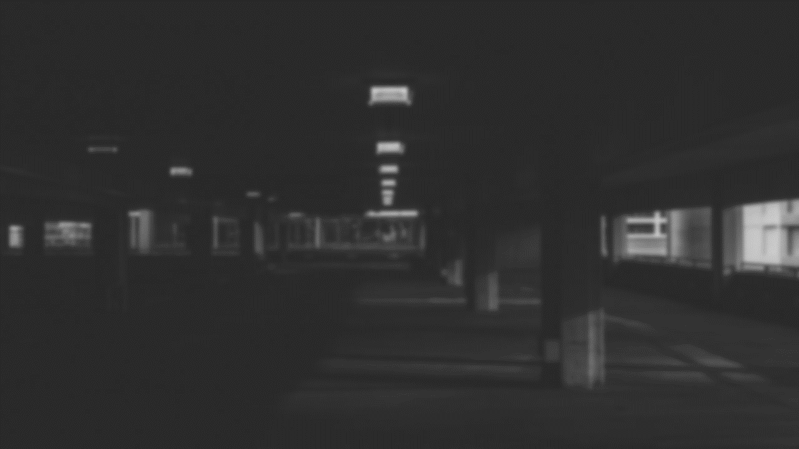
Easy Parking

Slide 2


Summary
Parking is a major problem in both developed and developing countries. The main cause of the problem is a severe discrepancy between the locations of parking and number of vehicles
With the advancement of technology, there are attempts to find smart solutions for this crisis .one of them is smart parking applications
The cameras in shops are used and a connection is made with the application, so that the user logs into the application and specifies the name of the street in which the stop is required and is connected to the cameras on the street so that the cameras show the driver's free spaces

Slide 3
Project Charter
Official project name: Easy Parking
Project sponsor: Traffic department
Project manager: Mostafa Mohamed Ahmed
Project members: Mostafa Mohamed - Mahmoud Ayman - Mahmoud Ali - Yasmeen Khaled - Mariam Alaa
Project Purpose :
Helping people to parking their cars easily via using an application that can find an empty parking for them.
Assumption:
1- will get all resources required.
2- make a regular meeting with the team.
3- collect data from stakeholders and review the team progress with them

Slide 4
1- Objectives:
Project Scope
Reduce traffic jams .
Keep income for necessities of life .
Reduce accidents and crashes which happen when people park .
See the parking space size .

Slide 5
2- Deliverables:
Permission from shop owners to use their cameras.
Software.
Data base.
Integration.

Slide 6
3- Milestones:
Requirements review : Requirements specifications are complete, correct, approved and suitable. By 1/11/2021
Critical design review: Detailed designs fully implement the system architecture, are approved and are suitable for input into the development of code. By 15/11/2021.
System test review : The software product has passed system testing and is suitable for input into acceptance testing. By 3/2/2022
Product operational: The software is in use in its target operational environment. By 17/2/2022.

Slide 7
Project resources
Hardware :
10 PC .
3 Servers.
Staff :
Team android developers .
Team network Engineer .
Team UI design.

Slide 8
Budget
budget allocated for this project is 600000 L.E (including servers, devices, developers and training).
Communication management
1- Conducting a weekly meeting between each department and the
leader to discuss and solve problems and discuss suggestions to
improve the quality of the application.
2- Meeting between the heads of the departments and the head of
the company to discuss the latest developments

Slide 9
Limits & Exclusions
Limits :
Exclusions :
The project must be ready at the end of February .
The application must connect to the cameras to know the nearest and best place for the user .
The application will be for Android .
The project don't use sensors .
The project don’t have responsibility for security of the shops .
There is no wages for the owners of the shops .
The application will not be for web .

Slide 10
WBS Structure :
1
EP
1.2
software
1.2.1
UI design
1.2.2
Android app design
1.4
integration
1.2.3
Network processing
1.2.4
Test
1.3
Data Base
1.3.1
Reserve a server in google cloud
1.3.2
gathering information from Zone Traffic Department
1.1
Permission from shops

Slide 11
WBS Dictionary
Work Package | ID | Responsible | Start Date | End Date
Permission from shop | 1.1 | Mahmoud Ali | 24/11/2021 | 29/12/2021
UI design | 1.2.1 | Mariam | 29/12/2021 | 12/1/2022
Android App design | 1.2.2 | Mostafa | 29/12/2021 | 19/1/2022
Network processing | 1.2.3 | Yasmeen | 29/12/2021 | 5/1/2022
Test | 1.2.4 | Mahmoud Ayman | 19/1/2022 | 3/2/2022
Reserve a server in Google cloud | 1.3.1 | Yasmeen | 29/12/2021 | 5/1/2022
gathering information from Zone Traffic Department | 1.3.2 | Mahmoud Ali | 29/12/2021 | 5/1/2022
Integration | 1.4 | Mahmoud Ayman | 3/2/2022 | 17/2/2022

Slide 12
Responsibility matrix :
List of task Member | Mahmoud Ali | Mostafa | Mariam | Mahmoud | Yasmeen
Permission from shop | R |  |  |  | A
UI design |  |  | R
Android app design |  | R
Network processing |  |  |  |  | R
Test |  | A | A | R
Reserve a server in Google cloud |  |  |  |  | R
Gathering information from zone traffic department | R
Full test |  | A |  | R

Slide 13
Project network
Id description Preceding activity duration
A Permission from shop owners none 5
B UI design A 2
C Android app design A 3
D Network processing A 2
E Reserve a server in google cloud A 1
F gathering information A 1
G Test B,C,D 2
H Integration E,F 2

Slide 14
Network
7 | B | 5
 | UI design | 1
8 | 2 | 6
8 | C | 5
 | Android app design | 0
8 | 3 | 5
10 | G | 8
 | Test | 0
10 | 2 | 8
5 | A | 0
 | Permission from shop | 0
5 | 5 | 0
7 | D | 5
 | Network processing | 1
8 | 2 | 6
12 | H | 10
 | Integration | 0
12 | 2 | 10
6 | E | 5
 | Reserve a server in google | 4
10 | 1 | 9
6 | F | 5
 | Gathering Information | 4
10 | 1 | 9

Slide 15
Resource constrained
 | RES | DUR | ES | LF | SL | 0 | 1 | 2 | 3 | 4 | 5 | 6 | 7 | 8 | 9 | 10 | 11
A | 2 | 5 | 0 | 5 | 0 | 2 | 2 | 2 | 2 | 2
B | 1 | 2 | 5 | 8 | 1 |  |  |  |  |  | 1 | 1
C | 1 | 3 | 5 | 8 | 0 |  |  |  |  |  | 1 | 1 | 1
D | 1 | 2 | 5 | 8 | 1 |  |  |  |  |  | 1 | 1
E | 1 | 1 | 5 | 10 | 4 |  |  |  |  |  | 1
F | 1 | 1 | 5 | 10 | 4 |  |  |  |  |  | 1
G | 3 | 2 | 8 | 10 | 0 |  |  |  |  |  |  |  |  | 3 | 3
H | 2 | 2 | 10 | 12 | 0 |  |  |  |  |  |  |  |  |  |  | 2 | 2
Total Resource Load | 2 | 2 | 2 | 2 | 2 | 5 | 3 | 1 | 3 | 3 | 2 | 2
Resource Available | 5 | 5 | 5 | 5 | 5 | 5 | 5 | 5 | 5 | 5 | 5 | 5

Slide 16
Gantt Chart
ID | 0 | 1 | 2 | 3 | 4 | 5 | 6 | 7 | 8 | 9 | 10 | 11
A | √ | √ | √ | √ | √
B |  |  |  |  |  | √ | √
C |  |  |  |  |  | √ | √ | √
D |  |  |  |  |  | √ | √
E |  |  |  |  |  | √
F |  |  |  |  |  | √
G |  |  |  |  |  |  |  |  | √ | √
H |  |  |  |  |  |  |  |  |  |  | √ | √

Slide 17
Budget Baseline
ID | DUR | Task | Budget | 0 | 1 | 2 | 3 | 4 | 5 | 6 | 7 | 8 | 9 | 10 | 11
A | 5 | Permission from shop | 100 | 20 | 20 | 20 | 20 | 20
B | 2 | UI design | 14 |  |  |  |  |  | 7 | 7
C | 3 | Android App design | 30 |  |  |  |  |  | 10 | 10 | 10
D | 2 | Network processing | 30 |  |  |  |  |  | 15 | 15
E | 1 | Reserve a server in Google cloud | 5 |  |  |  |  |  | 5
F | 1 | gathering information from Zone Traffic Department | 25 |  |  |  |  |  | 25
G | 2 | Test | 20 |  |  |  |  |  |  |  |  | 10 | 10
H | 2 | Integration | 10 |  |  |  |  |  |  |  |  |  |  | 5 | 5
Total |  |  | 52 | 20 | 20 | 20 | 20 | 20 | 62 | 32 | 10 | 10 | 10 | 5 | 5
Commutative |  |  |  | 20 | 40 | 60 | 80 | 100 | 162 | 194 | 204 | 214 | 224 | 229 | 234

Slide 18
Commutative Budget
Baseline
Weeks

Slide 19
Risk Management
Risk description | Probability risk | Impact of risk | Risk category | Solution
The location that the user will impact may be not clear | Medium | High | Performance | Input a detailed location
Poor resource plans result to delaying deadlines of the final product | Medium | High | Resource | Resources should be allocated before a project begins
The project cost risk is the risk that a project will spend more money than was originally budget | High | High | Budget | Ensuring strong plans are done for budget time and for tasks
Drop in a server | Medium | High | Performance | Develop a server contingency plan

Slide 20

Under supervision of
Ibrahim El-Semman
Team members
“ Mostafa Mohamed Ahmed - Mahmoud Ayman Hashim –
Mahmoud Ali Abd Elftah - Yasmeen Khaled Farhan - Mariam Alaa El-Din “
..Thank you..

